Slide 1
The Fourteenth Amendment: Transforming American Democracy
Separation of Powers

Slide 4
Overview
Federal Government
Executive – President, Cabinet
Legislative – House, Senate
Judicial – Federal court system
State level
Executive - Governor
Legislative – State Legislature
Judicial – State courts
Checks and balances to prevent abuse of power

Slide 5
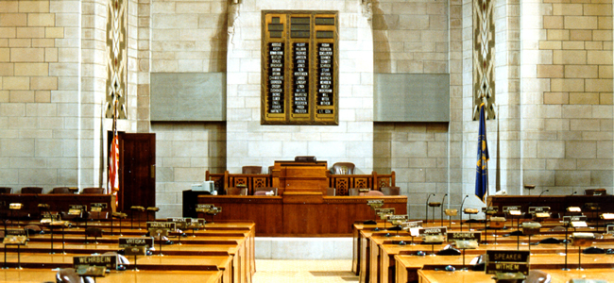
Legislative Branch
Federal: Bicameral, Congress
Senate
House
Nebraska: Unicameral
Congress’s powers
Introduce new laws;
Override a presidential veto;
Coin money;
Borrow money on behalf of the United States;
Appropriate money to the executive branch;
Declare war; and
Impeach or remove the president

Slide 6
Legislative Branch
The legislative branch can check the powers of the executive branch by:
Overriding a veto
Impeachment
Approving Presidential appointments to the Supreme Court, the Cabinet, and federal agencies (like the F.B.I.).
The legislative branch can check the powers of the Supreme Court by:
Confirming judiciary appointments to the Court;
Impeaching or removing justices; and
Proposing new amendments to the Constitution.

Slide 7
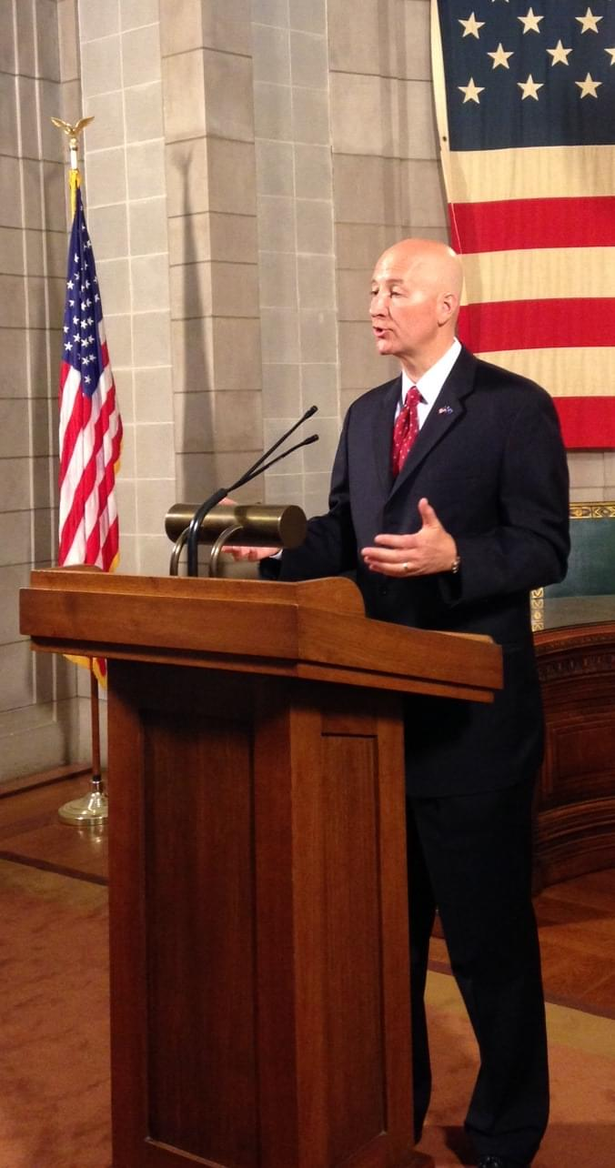
Executive Branch
President, Governor, or Mayor
Members of the Cabinet
Elected
Powers
Propose laws to the Congress (the legislative branch);
Sign bills into law;
Veto bills from becoming laws;
Negotiate treaties with foreign countries;
Make executive appointments
Grant pardons to federal offenders.

Slide 8
Executive Branch
The President or Governor can check the powers of the Congress by:
Proposing new legislation; and
Vetoing bills from becoming laws.
The President or Governor can check the powers of the Supreme Court by:
Appointing judges who share your political viewpoints; and
Enforcing the Court’s decisions.

Slide 9
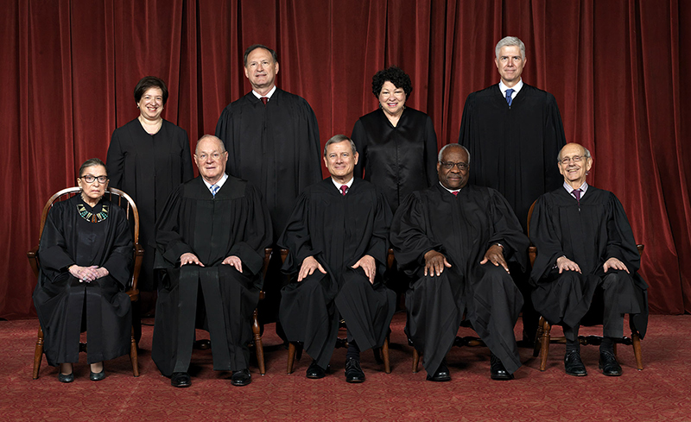
Judicial Branch
U.S. Supreme Court
Justices
Appointment
End of Term
Federal Judges
Nebraska Supreme Court
Court of Appeals
District Court
County Court

Slide 10
Judicial Branch
Members of the judicial branch, have the power to:
Declare laws unconstitutional; and
Interpret/Make meaning of laws.
The Judicial Branch can check the powers of the Executive Branch by:
Declaring executive acts unconstitutional.
The Judicial Branch can check the powers of the Congress by:
Declaring laws unconstitutional.

Slide 11
Who’s got the power?
Power | Branch
Introduces laws
Declares laws unconstitutional
Signs bills into law
Coins money
Nominates Supreme Court justices
Declares war

Slide 12
Who’s got the power?
Power | Branch
Introduces laws | Legislative
Declares laws unconstitutional
Signs bills into law
Coins money
Nominates Supreme Court justices
Declares war

Slide 13
Who’s got the power?
Power | Branch
Introduces laws | Legislative
Declares laws unconstitutional | Judicial
Signs bills into law
Coins money
Nominates Supreme Court justices
Declares war

Slide 14
Who’s got the power?
Power | Branch
Introduces laws | Legislative
Declares laws unconstitutional | Judicial
Signs bills into law | Executive
Coins money
Nominates Supreme Court justices
Declares war

Slide 15
Who’s got the power?
Power | Branch
Introduces laws | Legislative
Declares laws unconstitutional | Judicial
Signs bills into law | Executive
Coins money | Legislative
Nominates Supreme Court justices
Declares war

Slide 16
Who’s got the power?
Power | Branch
Introduces laws | Legislative
Declares laws unconstitutional | Judicial
Signs bills into law | Executive
Coins money | Legislative
Nominates Supreme Court justices | Executive
Declares war

Slide 17
Who’s got the power?
Power | Branch
Introduces laws | Legislative
Declares laws unconstitutional | Judicial
Signs bills into law | Executive
Coins money | Legislative
Nominates Supreme Court justices | Executive
Declares war | Legislative

Slide 18
SCENARIO #1 (Youngstown Sheet & Tube Co. v. Sawyer, 343 U.S. 579)
On December 18, 1951, collective bargaining between steel companies and their employees broke down and led to a strike scheduled to begin on December 31, 1951. Mediation was attempted by the Federal Mediation and Conciliation Service, but was ultimately unsuccessful and a new strike date was set for April 9, 1952.
As the US was currently involved in the Korean War, President Truman believed that a strike of any length would interfere with defense contractors and the domestic economy. Unable to mediate the issues between the union and the industry, President Truman signed an executive order on April 8, 1952, authorizing the Secretary of Commerce to take possession of and operate the privately-owned steel mills. He informed Congress of his plan and was willing to defer to the will of the legislative branch, but Congress took no action.
The steel companies brought suit in US District Court. The Court issued an injunction barring the government from continuing to hold the steel plants it had seized. The US Court of Appeals stayed this decision and the case went to the US Supreme Court.

Slide 19
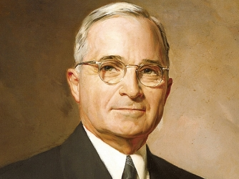
Youngstown Sheet & Tube Co. v. Sawyer, 343 U.S. 579
1951
Korean War
Which branches of government are at play here?
What authority is being asserted?
Which branch is exercising authority and which is checking?

Slide 20
SCENARIO #2 (US v. Nixon, 418 U.S. 683)
Toward the end of the 1972 presidential election, a group of burglars broke into the Democratic Party campaign headquarters at the Watergate Hotel in Washington D.C. Reporters uncovered that high-ranking government officials, possibly including then-president Richard Nixon himself, were involved in the burglary. Nixon was seeking a second term. Under congressional and public pressure, Nixon appointed a special prosecutor. The special prosecutor’s investigation revealed that Nixon had secretly recorded conversations in the Oval Office regarding the burglary.
In 1974, after seven of the president’s associates were indicted, a federal subpoena was issued requiring Nixon to turn over the tapes. Nixon’s counsel attempted to quash the subpoena citing “executive privilege” and arguing that presidents sometimes needed certain things to remain private and confidential. The District Court denied the request and the matter quickly proceeded to the Supreme Court.

Slide 21
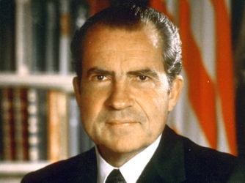
US v. Nixon, 418 U.S. 683
1972
Watergate Hotel
Which branches of government are at play here?
What authority is being asserted?
Which branch is exercising authority and which is checking?

Slide 22
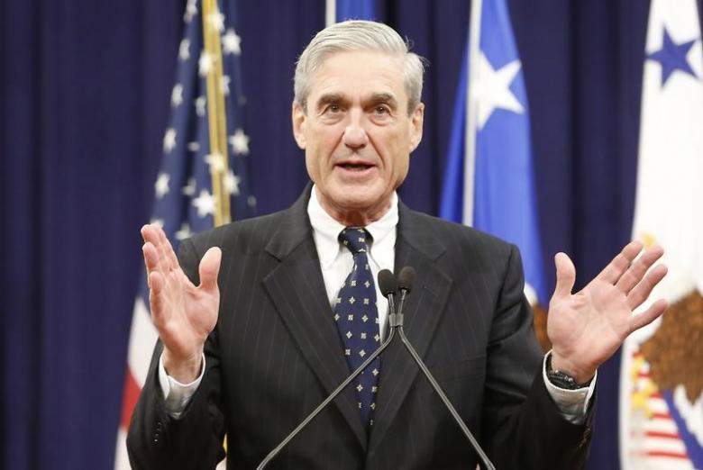
US v. Nixon, 418 U.S. 683
What problems can you foresee arising out of this situation if our system of checks and balances did not exist? Can you give an example?
Ethics in Government Act of 1978 created the “independent counsel.”
Do you think the creation of the independent counsel was an unconstitutional breach of executive power? Why/why not?
Can anyone name a current or former independent or special counsel and who or what they were investigating?

Slide 23
Local Example: Governor involvement with the Nebraska legislature
Having the Lt. Governor preside over the legislature.
Having a lobbyist in contact with senators to advance his agenda.
Openly donating money to candidates that are challenging senators up for re-election when those senators have disagreed with his agenda.
Is this problematic or reasonable?
Should the governor have any contact with the legislative body in an attempt to influence the process or wait until a bill comes to his desk?
Should that be the way a governor can exercise his or her power regarding new laws and check the power of the legislative branch?

Slide 24
Further Discussion
What accounts for the tension that can occur between the branches of government?
How can this tension be good and bad?
How does politics muddy the principle of separation of powers? Or does it have a role at all?

